Slide 1

CSE 6363: Project Review 3
<Mihir Ingole, Eldho Joy, Dannasri Srinivasan>

Slide 2
Introduction
Dataset
Pre-processing
Architecture
Model
Differences
Conclusion

Slide 3
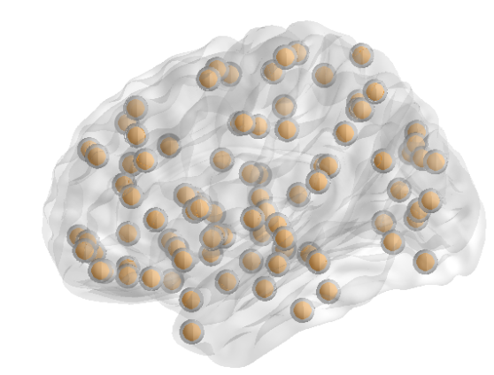
Classification of Autism Spectrum disorder using computer vision with deep learning and the ABIDE dataset
CC400 functional parcellation atlas

Slide 4
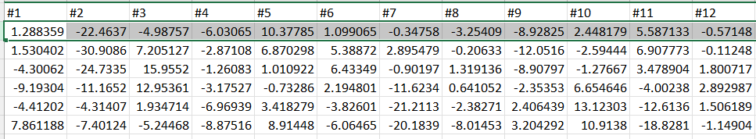

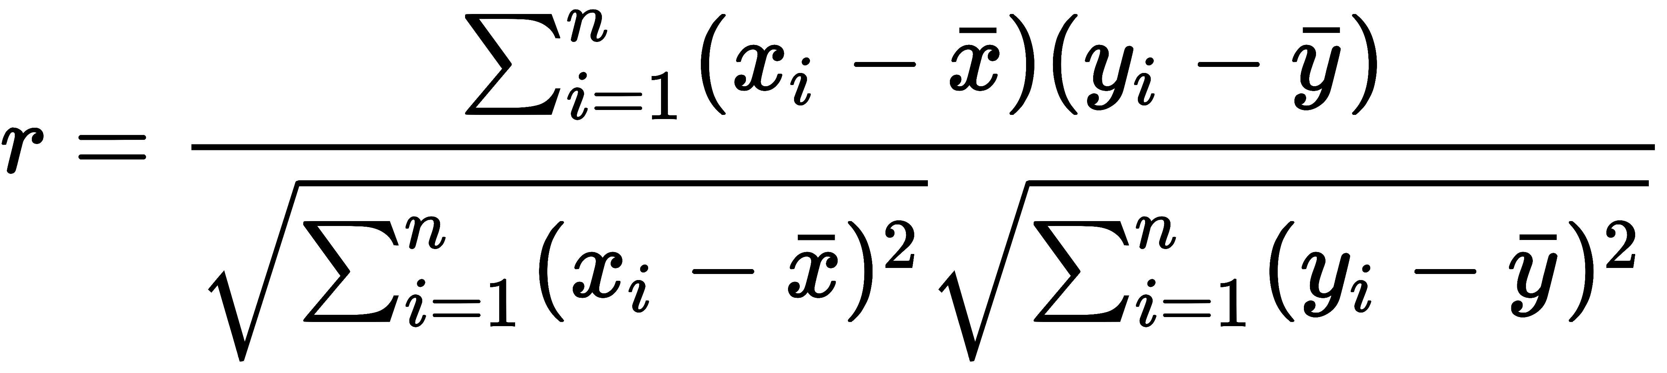
ABIDE Preprocessing
fMRI data after Band Pass Filtering and Global Signal Regression.
Pearson Correlation Coefficient

Slide 5
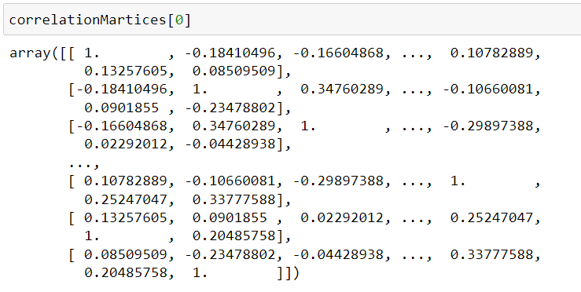

Pre-processing the fMRI time-series Creating Correlation Matrices using PCC

Slide 6
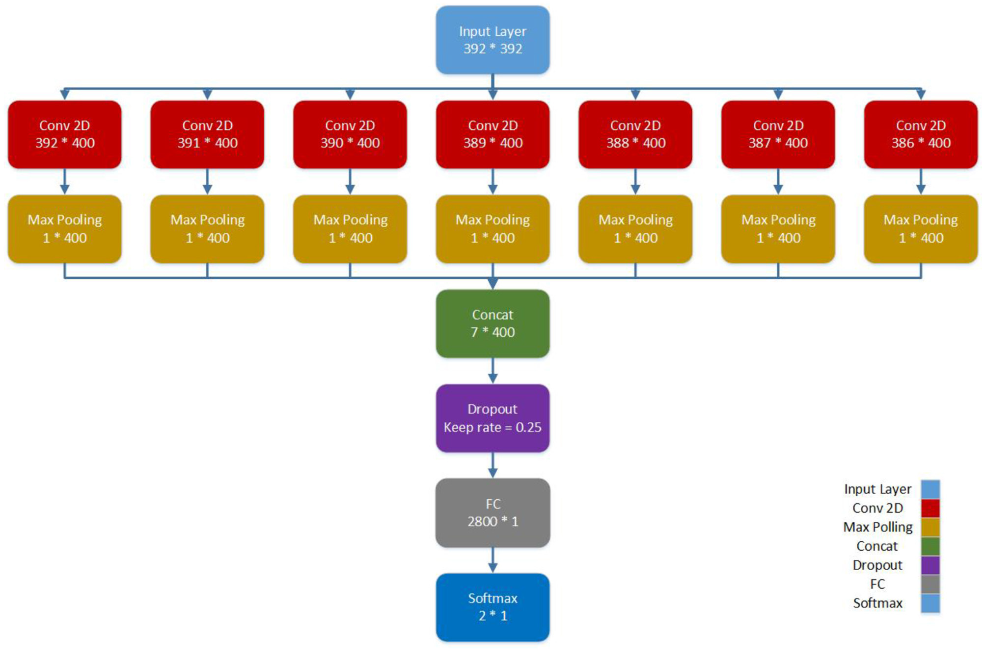
CNN Architecture

Slide 7
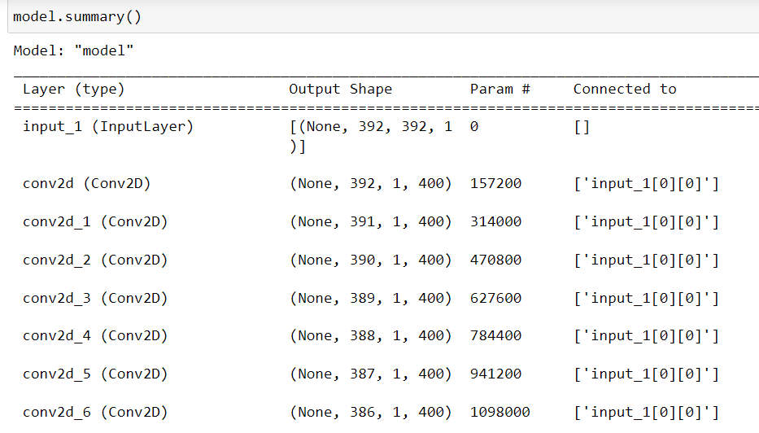
Model Implementation

Slide 8
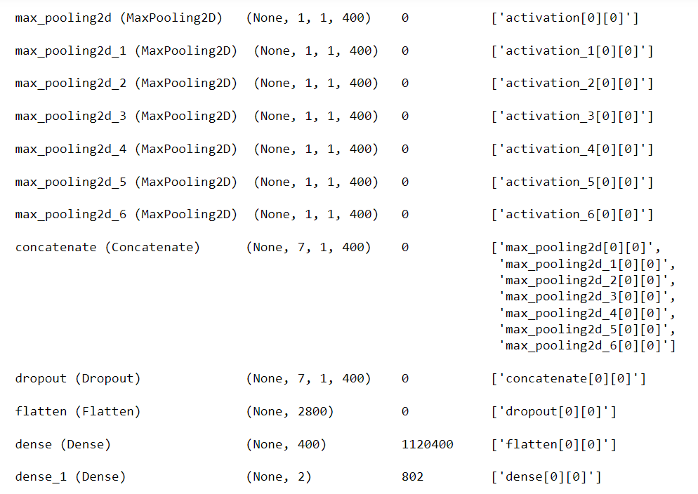
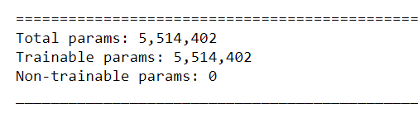
Model Implementation and Differences

Slide 9
Model Hyperparameters
Activations: tanh and softmax
Loss: Sparse Categorical Crossentropy
Optimizer: Adam
Learning Rate: 0.005
Batch Size: 32
Epochs: 300
Strategy: 10-fold cross-validation

Slide 10
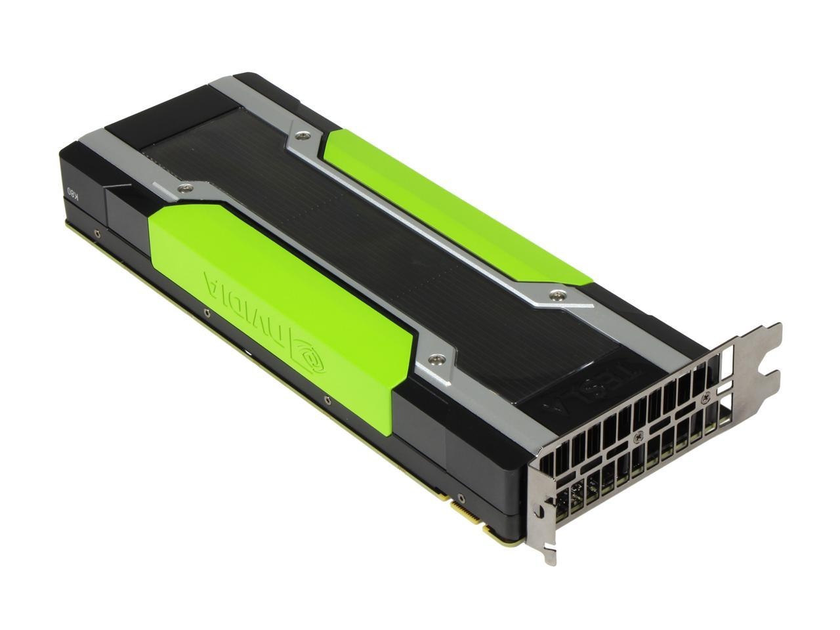
Specifications of resources used
Used by our team.
GPU: NVIDIA GeForce RTX 3050 Ti
Processor: AMD Ryzen 7 5800H Processor (8 Core)
16 GB DDR5 RAM and SSD
And Google Colab
Used by the authors of this study.
NVIDIA Tesla K80 model GPU
24GB GDDR5

Slide 11
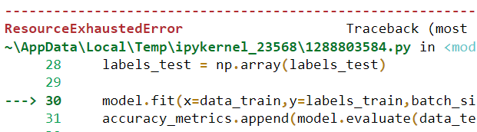
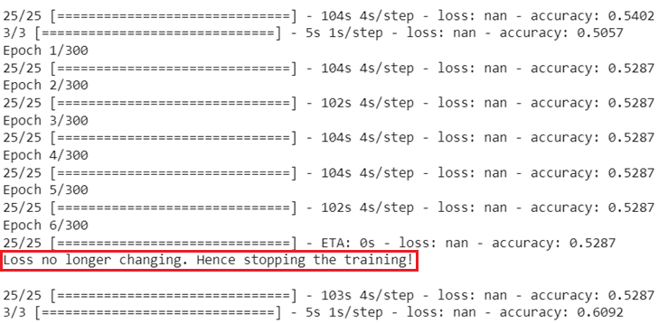
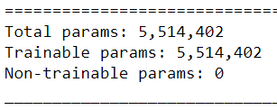
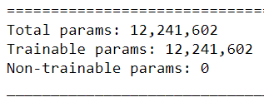
Challenges and limitations.

Slide 12
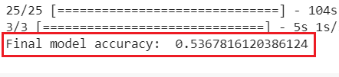

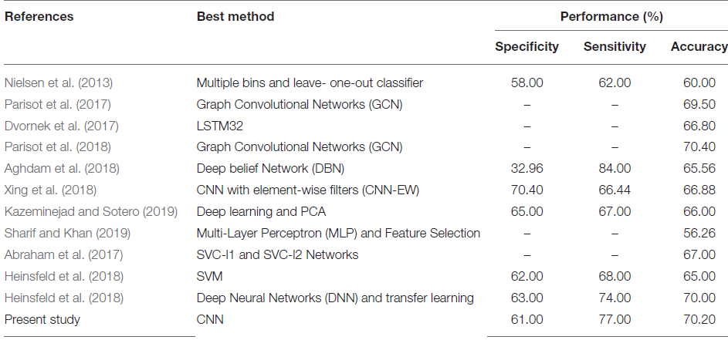
Accuracy and Comparison.
Accuracy on best fold:

Slide 13
Thank You!

